Slide 1
Helm The package manager for Kubernetes
From zero to hero
Daniel Hasselwander

Slide 2
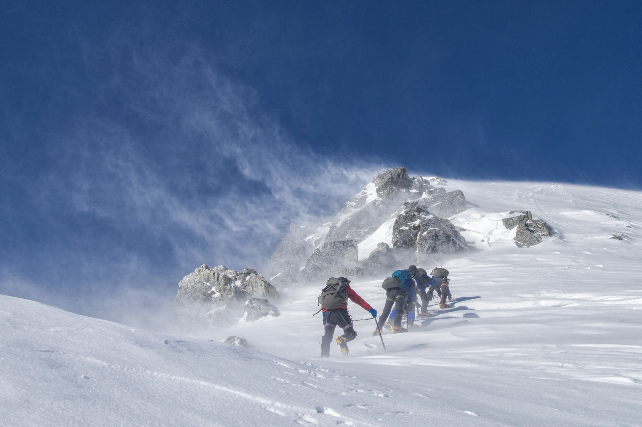

Agenda
Introduction
Helm Introduction
Helm Chart
Write own charts
Types of Charts
OCI vs non OCI Charts
Feedback and Learnings
Notes:
Introduction to Helm
Usage
Versioning
Definition of charts
Alternatives to Helm
Creating own Helm charts
Templating
Functions
Hooks
Testing
Debugging
Types of charts
Application, library, and umbrella charts
Static analysis of charts and best practices
OCI vs non OCI charts

Slide 3


Planned End of a day and meals
End of the day
11:30
Breaks
1h learn, 10 min break

Slide 4




Who I am ?
Notes:
Work as a Azure Cloud Enginner
ti&m Zürich
CKAD since Dez. 2020
Working against cluster application since 2019
Concepts for Applications on Azure

Slide 5
https://forms.gle/75r8e9RqTUHHCnFe9
Who are you ?
Do you use kubernetes regular ?
Do you have experience with helm ?
Whats your expectation for today ?

Slide 6

Course Documents
Everything will be uploaded to github
https://github.com/Hassel93/helm_course

Slide 7
Required Knowledge and Tools
Knowledge
Kubernetes Fundamentals
Linux Basics
How to work with Git ?
Tools
Some Shell
Yaml Editor

Slide 8
Obtain required resource access
You got your kube config ?
Everyone can access to their k8s-cluster ?
export KUBECONFIG=/path/to/your/kubeconfig
Clone the github repo ?
git clone https://github.com/Hassel93/helm_course

Slide 9

Learning Objectives of today
What is Helm
Competitor products
Why you should use helm
Structure of helm
How you can work with helm
How you can write and test your own helm charts
How you can identitfy the several types of helm charts

Slide 10
Credits
Kubernetes Fundamentals Slides from Marc Menzinger
Kubernetes icons © Community & Linux Foundation, distributed under CC-BY-4.0 https://github.com/kubernetes/community/tree/master/icons
Helm Docs https://helm.sh/docs/
Kubernetes docs © Documentation Authors, distributed under CC-BY-4.0 https://kubernetes.io/docs/home/

Slide 11


